Slide 1
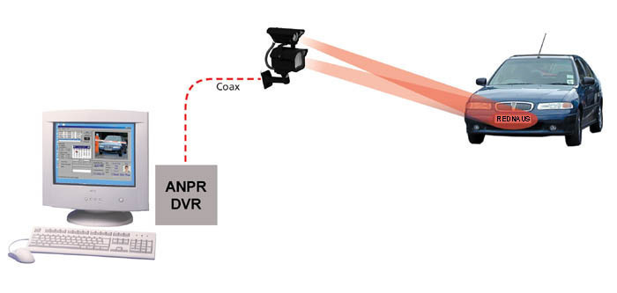
Vehicle Number Plate Scanning System(VNPSS)
VNPSS
Presented by
Bibek Acharya
Ganesh Poudel
Nabin Magar

Slide 2
Key Concept
Introduction
Open CV
Objectives
Limitations
Methodology(Agile Process Model)
Feasibility
System Design
Flow chart
Use Case Diagram
Sequence Diagram
Activity Diagram

Slide 3
Introduction
A vehicle number plate is a metal or plastic plate attached to a vehicles which are different for every vehicles and that is for official identification purposes.
The number plate are attached on the front and back side of vehicles.

Slide 4
Vehicle Number Plate Scanning System (VNPSS)
VNPSS is an image-processing technology which is used to identify vehicles by their number plate using OCR(Optical Character Recognition).
This technology is used for traffic management purpose, Identification of stolen cars, Security control of restricted access areas, unattended parking lots etc

Slide 5
Various names of this technology are:
Lisence plate Recognition(LPR)
Car Registration System(CRS)
Intelligent Transport System(ITS)

Slide 6
Objectives
To use for Security control of restricted access areas, vehicle tracking and monitoring, border crossing, security.
to reduce excessive time for registration of vehicle number.
to change the current traditional registration system i.e handwritten.

Slide 7
Open CV
It’s Library is a common platform and set of programming functions for real-time applications and contains several algorithms for more than 500 optimized algorithms.
It supports a vast programming languages such as C ++, Python, Java and others, and is available on different platforms such as Windows, Linux, OS X, Android, iOS, and so on.
Here in this system, we used Python as a code language. It is called Open CV Python

Slide 8
Elements In VNPSS
Camera
Iilumination
Computer
Software
Hardware
Database

Slide 9
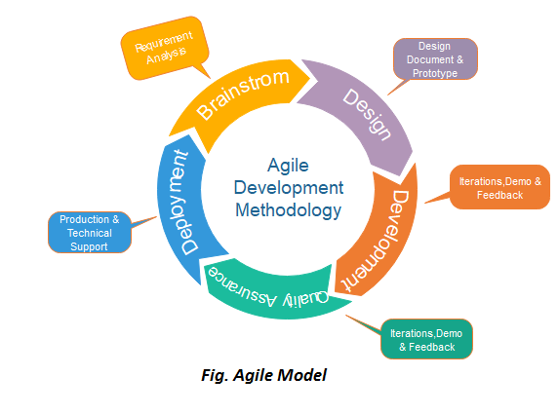
Methodology(Agile Process Model)
It refers to a software development approach based on iterative development.
This methods break tasks into smaller iterations, or parts do not directly involve long term planning.
Following are the phases in the Agile model are as follows:
Requirements gathering
Design the requirements
Construction/ iteration
Testing/ Quality assurance
Deployment
Feedback

Slide 10
Why we choose Agile Process Model?
Lower Cost
Providing teams with a competitive advantage by catching defects and making changes throughout the development process, instead of at the end.
Speeds up time spent on evaluations since each evaluation is only on a small part of the whole project.
Ensures changes can be made quicker and throughout the development process by having consistent evaluations to assess the product with the expected outcomes requested.
Encourages open communication among team members, and clients.

Slide 11
Feasibility Study
Technical Feasibility:
To develop our project, we may require other vast technology. It can be developed under the existing technology.
Economic Feasibility:
The project that we are developing is economically feasible in the sense that it may or may not require high budget, investment, initial fund to develop and, only free software tools will be used to develop.

Slide 12
Feasibility Study
Legal Feasibility:
Legal feasibility means that the project that we are developing does not violate any legal rules and regulations. The project that we are developing does not break any legal rules. So, the project is legally feasible.
Operational Feasibility:
Operational feasibility is the measure of how well a proposed system solves the problems, andtakes advantage of the opportunities identified during scope definition and how it satisfies the requirements identified in the requirements analysis phase of system development.

Slide 13
System Design

Slide 14
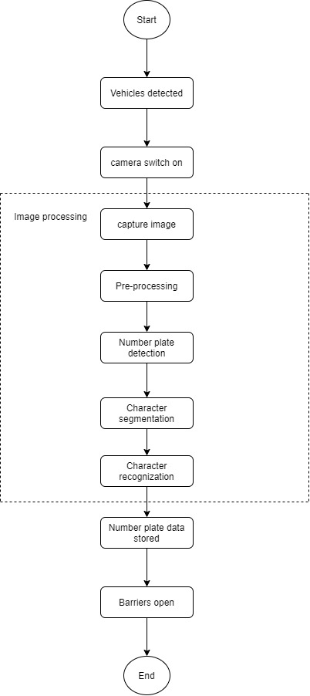
Flow chart
fig(1): Flow chart of VNPSS

Slide 15
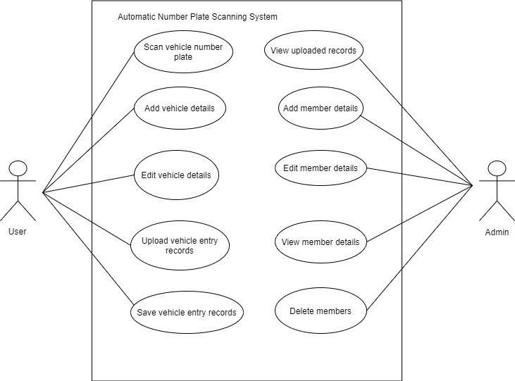
Use case Diagram
fig(2): Use case Diagram of VNPSS in terms of Admin and user view

Slide 16
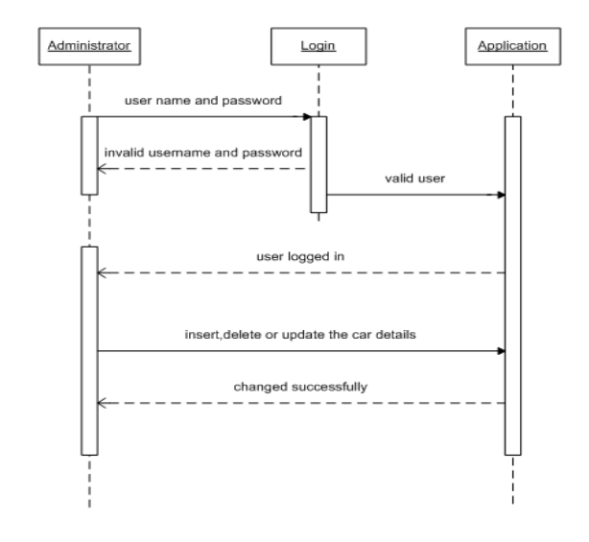
Sequence Diagram
Fig(3): Sequence diagram for administration

Slide 17
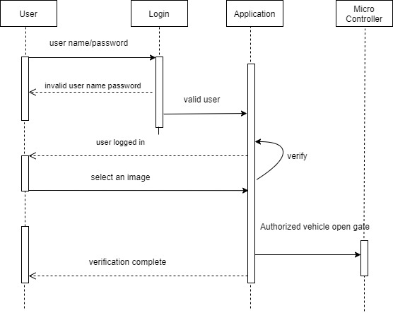
Sequence Diagram
fig(4): Sequence diagram Authorized vehicle

Slide 18
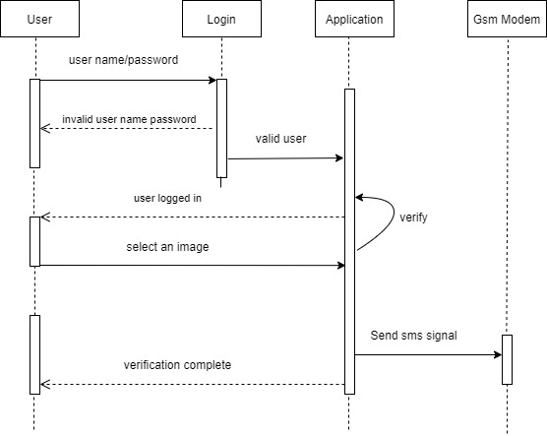
Sequence Diagram
fig(4): Sequence diagram of unauthorized vehicle

Slide 19
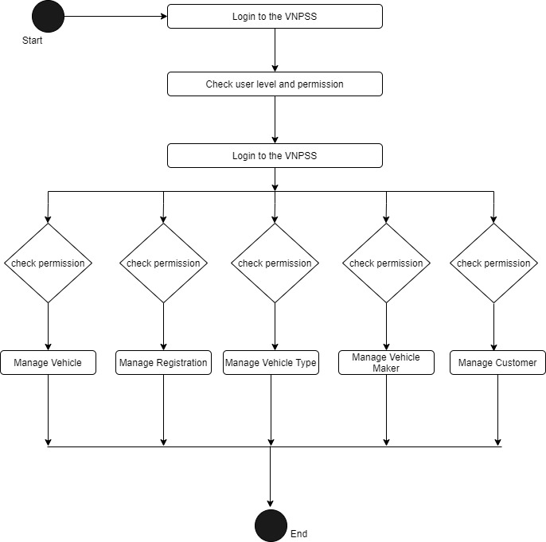
Activity Diagram
Fig(6): Activity diagram for VNPSS

Slide 20
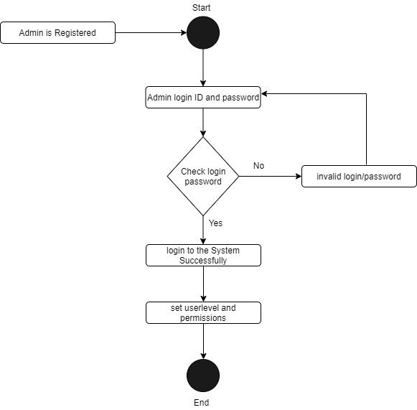
Activity Diagram
Fig(7): Admin Activity Diagram

Slide 21
Required Library
OpenCV Python
Python-tesseract
Numpy
MYSQL
PysimpleGUI

Slide 22
Approach
Find all the contours in the image.
Find the bounding rectangle of every contour.
Compare and validate the sides ratio and area of every bounding rectangle with an average license plate.
Apply image segmentation in the image inside validated contour to find characters in it.
Recognize characters using an OCR.

Slide 23
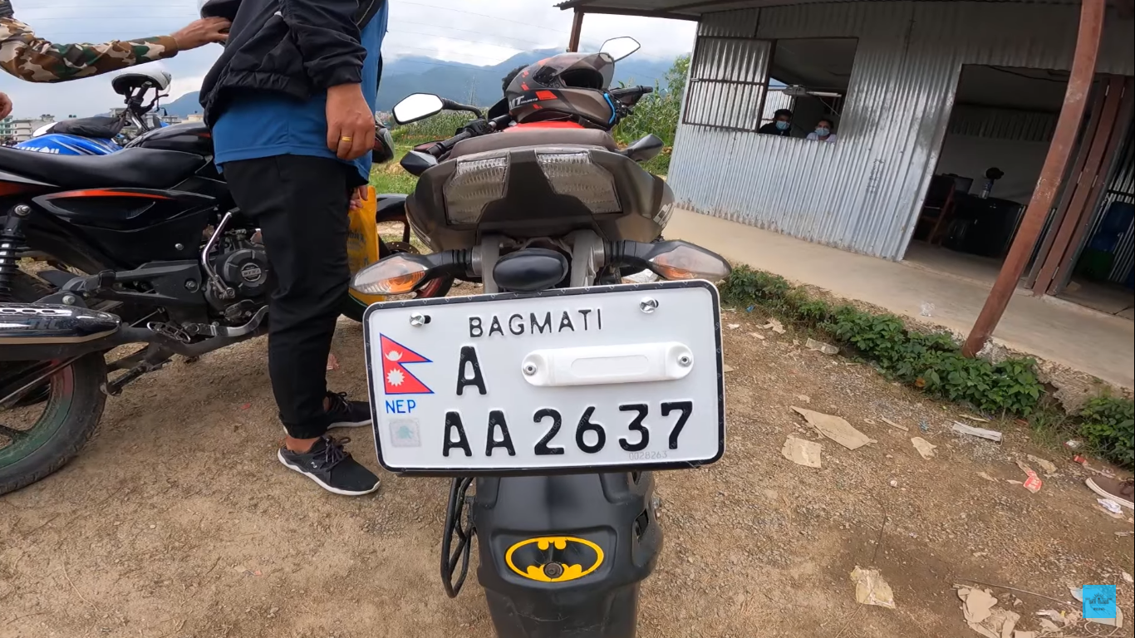
Inputs
different weather conditions, orientations and speed at which vehicle was moving when the image was captured pose more challenges to this problem.
difficult to recognize the number properly during night time.

Slide 24
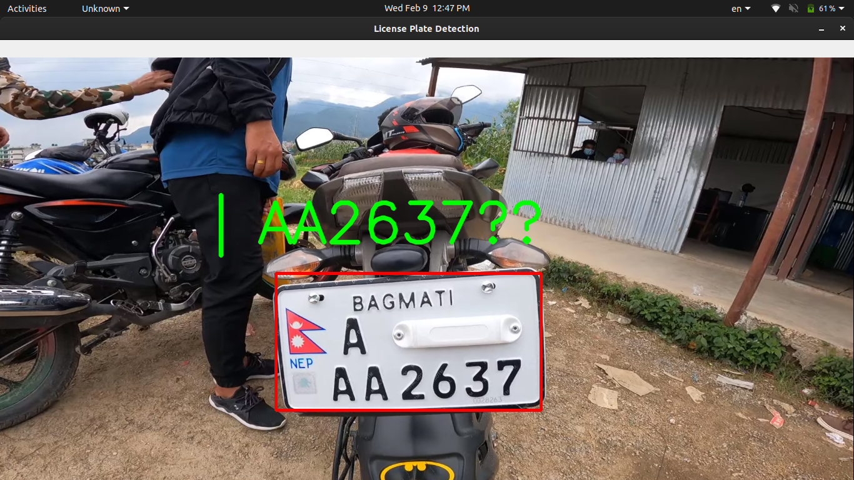
outputs
different weather conditions, orientations and speed at which vehicle was moving when the image was captured pose more challenges to this problem.
difficult to recognize the number properly during night time.

Slide 25
different weather conditions, orientations and speed at which vehicle was moving when the image was captured pose more challenges to this problem.
difficult to recognize the number properly during night time.
steps

Slide 26
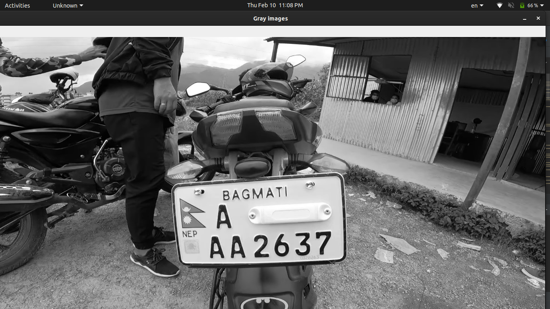
First of all we convert image into the grayscale.
different weather conditions, orientations and speed at which vehicle was moving when the image was captured pose more challenges to this problem.
difficult to recognize the number properly during night time.

Slide 27
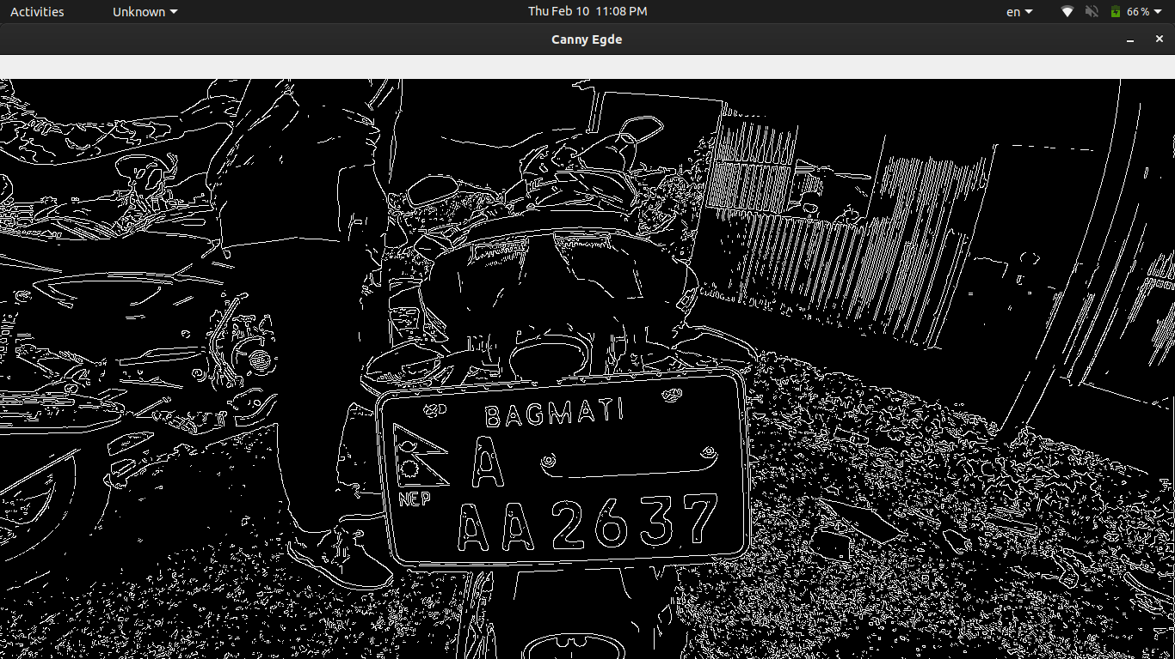
2. Find vertical edges in the image.
different weather conditions, orientations and speed at which vehicle was moving when the image was captured pose more challenges to this problem.
difficult to recognize the number properly during night time.

Slide 28
different weather conditions, orientations and speed at which vehicle was moving when the image was captured pose more challenges to this problem.
4. find contours based on edges.
5. Initialize license plate contours and x,y coordinates.
6. Find the contour with 4 potential corners and create ROI around it.
Removing Noise from the detected image, before sending to tesseractdifficult to recognize the number properly during night time.

Slide 29
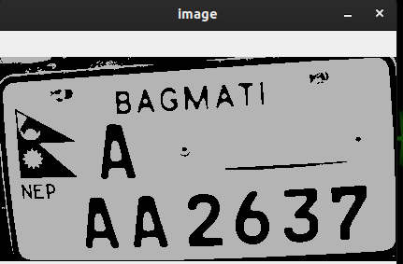
7.Removing Noise from the detected image, before sending to tesseract
8. Text recognitiona
9. Draw license plate and write the text
Removing Noise from the detected image, before sending to tesseractdifficult to recognize the number properly during night time.

Slide 30
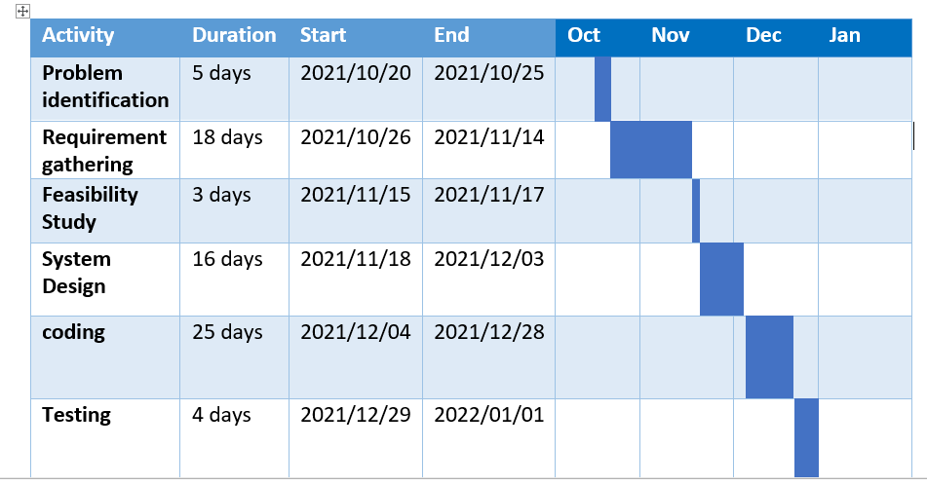
Gantt Chart

Slide 31
Thank you!!

